Slide 1

AI-600 DEEP LEARNING · PROJECT #10
RESEARCH PRESENTATION
Graph Neural Networks for
Drug–Drug Interaction Prediction
BioSNAP ChCh-Miner · Link Prediction · OOD Evaluation · MC Dropout
AUTHORS
FIVE MODEL CONFIGURATIONS
Usman Naeem 25280021
MLP Baseline
Sarmad Ali 25280037
GCN + Dot
Hammad 25280041
GCN + MLP ★ Best
GIN + Dot
May 2026
GIN + MLP
Notes:
1

Slide 2
Problem Statement
01 / 05
THE CHALLENGE
Polypharmacy is rising — patients on multiple drugs simultaneously
DDIs cause adverse events neither drug produces alone
FDA: DDIs cause ~2.8% of all hospital admissions annually
With N drugs, the search space is O(N²) — exhaustive wet-lab screening is infeasible
LINK PREDICTION TASK
Drug A
OUR APPROACH — GRAPH LINK PREDICTION
Represent the DDI database as a graph G = (V, E)
Drugs → nodes with molecular fingerprint features
Known interactions → edges
Predict: does an unobserved drug pair interact?
Drug B
Drug C
Drug D
O(N²)
2.8%
GNN
Interaction
search space
Hospital admissions
from DDIs
Features +
graph topology
Known DDI
Predict?
Score the dashed candidate edge
GNN · DDI Prediction · BioSNAP
AI-600 · Project #10
Notes:
2

Slide 3
Dataset Description
02 / 05
BIOSNAP CHCH-MINER
KEY STATISTICS
Binary DDI edges mined from DrugBank co-administration records
Drug SMILES fetched from PubChem REST API, cached locally
Node features: 2,048-bit Morgan fingerprints (ECFP4, radius 2) via RDKit
1,338
41,820
Drug nodes
(valid SMILES)
Known DDI
edges
2,048
ECFP4
DATA SPLITS — 1:1 NEGATIVE SAMPLING
Node feature
dimension
Morgan FP
radius 2
Split | Pos. Edges | Neg. Edges | Share
Train | 33,456 | 33,456 | 80%
Val | 4,182 | 4,182 | 10%
Test | 4,182 | 4,182 | 10%
FEATURE PIPELINE
SMILES
RDKit
Node x
string
Morgan FP
ℝ²⁰⁴⁸
From raw molecular structure to 2,048-dim feature vector
GNN · DDI Prediction · BioSNAP
AI-600 · Project #10
Notes:
3

Slide 4
Methodology
03 / 05
ENCODER → DECODER ARCHITECTURE
FIVE CONFIGURATIONS
Node features
Model | Encoder | Decoder
MLP Baseline | — | MLP on [xᵤ‖xᵥ]
GCN + Dot | GCN | Dot product
GCN + MLP ★ | GCN | MLP
GIN + Dot | GIN | Dot product
GIN + MLP | GIN | MLP
x ∈ ℝ²⁰⁴⁸
GCN or GIN Conv₁ + BatchNorm + ReLU + Dropout(0.3)
2048 → 256
GCN or GIN Conv₂ + BatchNorm + ReLU + Dropout(0.3)
256 → 64
TRAINING SETUP
Decoder
Loss: Binary Cross-Entropy, 1:1 negatives
Optimiser: Adam · lr 1e-3 · wd 1e-5
Early stop: patience 20 on Val AUC, max 150 epochs
Hardware: Apple M4 MPS · seed 42
Dot: σ(zᵤᵀzᵥ) | MLP: [zᵤ‖zᵥ] → 128 → 64 → 1
ŷ ∈ [0, 1]
interaction probability
UNCERTAINTY & OOD PROTOCOL
MC Dropout: 20 stochastic passes → epistemic std
Cold-start: 15% of nodes held out entirely at train time
GNN · DDI Prediction · BioSNAP
AI-600 · Project #10
Notes:
4

Slide 5
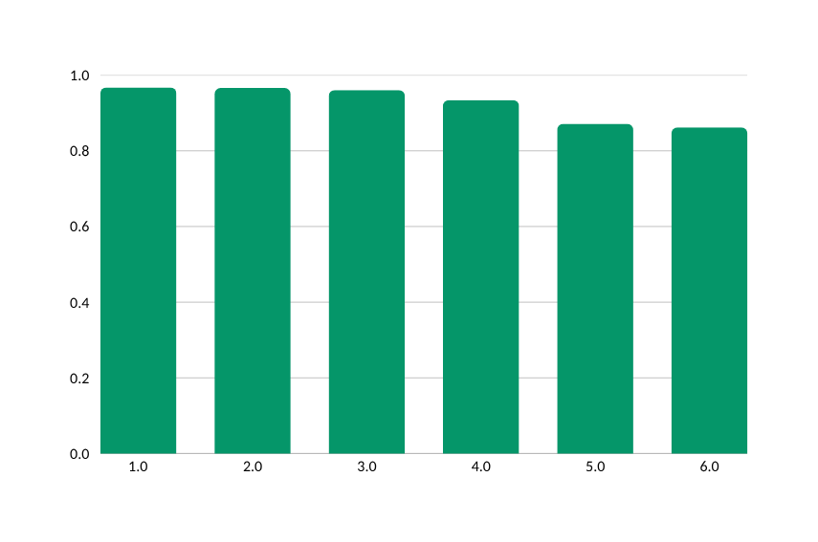
Results & Comparison with Baselines
04 / 05
IID BENCHMARK — BIOSNAP RANDOM SPLIT
GCN + MLP — KEY METRICS
Model | Val AUC | Test AUC | Test AP
MLP (Non-Relational) | 0.9707 | 0.9660 | 0.9584
GCN + Dot | 0.8731 | 0.8712 | 0.8675
GCN + MLP ★ | 0.9723 | 0.9675 | 0.9655
GIN + Dot | 0.8957 | 0.8618 | 0.8109
GIN + MLP | 0.9634 | 0.9606 | 0.9541
EmerGNN 2023 † | — | 0.9340 | —
0.9675
0.9655
Test ROC-AUC
Test Avg. Precision
0.0156
0.0518
ECE (calibration)
MC Dropout std
TEST AUC — ALL MODELS
† Zhang et al. (2023) — published SOTA on BioSNAP DDI
⚡
Decoder is the dominant factor
GCN+MLP (0.968) vs GCN+Dot (0.871) = +0.097 AUC — larger than any encoder gap
🏆
Beats published SOTA by +3.4 pp
GCN+MLP 0.9675 vs EmerGNN 0.9340 — with a simpler architecture
GNN · DDI Prediction · BioSNAP
AI-600 · Project #10
Notes:
5

Slide 6
OOD Generalization & Conclusions
05 / 05
COLD-START OOD EVALUATION
KEY TAKEAWAYS
Hold out 15% of drug nodes (≈ 200). Test on edges between unseen drugs only. GNNs aggregate from seen neighbours via inductive message passing.
Decoder > Encoder
1
MLP decoder adds +0.096 AUC over dot product — non-linear scoring is critical
Model | IID AUC | OOD AUC | Δ
MLP | 0.9660 | 0.6124 | −0.354
GCN + MLP | 0.9675 | 0.8697 | −0.098
GCN+MLP beats SOTA
2
0.9675 vs EmerGNN 0.934 (+3.4 pp) with a simpler architecture
3
2-layer GCN at d=64 is optimal
3 layers → over-smoothing (−0.020); larger d → overfitting
⚠
MLP nearly collapses on OOD
4
Graph topology enables OOD robustness
Relies purely on molecular features — no graph → 0.612 AUC on cold-start
GCN uses seen-neighbour context; MLP cannot generalise to new drugs
✓
GCN retains 0.870 AUC cold-start
5
Well-calibrated + uncertainty-aware
Graph topology provides the OOD robustness advantage
ECE = 0.016 · MC Dropout flags risky OOD pairs at deployment
MC DROPOUT — IID VS OOD UNCERTAINTY
0.0160
0.0174
CODE & REPORT
github.com/usmanbinnaeem/dl-proj
IID mean std
OOD mean std (1.09×)
GNN · DDI Prediction · BioSNAP
AI-600 · Project #10
Notes:
6

Slide 7
AI-600 · PROJECT #10
Thank You
Questions & Discussion
Usman Naeem · Sarmad Ali · Hammad
github.com/usmanbinnaeem/dl-proj
Notes:
7

